Slide 1

Project Webapp Bartender Website
By Phạm Đinh Hoàng Việt,
Lê Thanh Phương Nam,
Đặng Đình Khang,
Phạm Công Tuấn

Slide 2

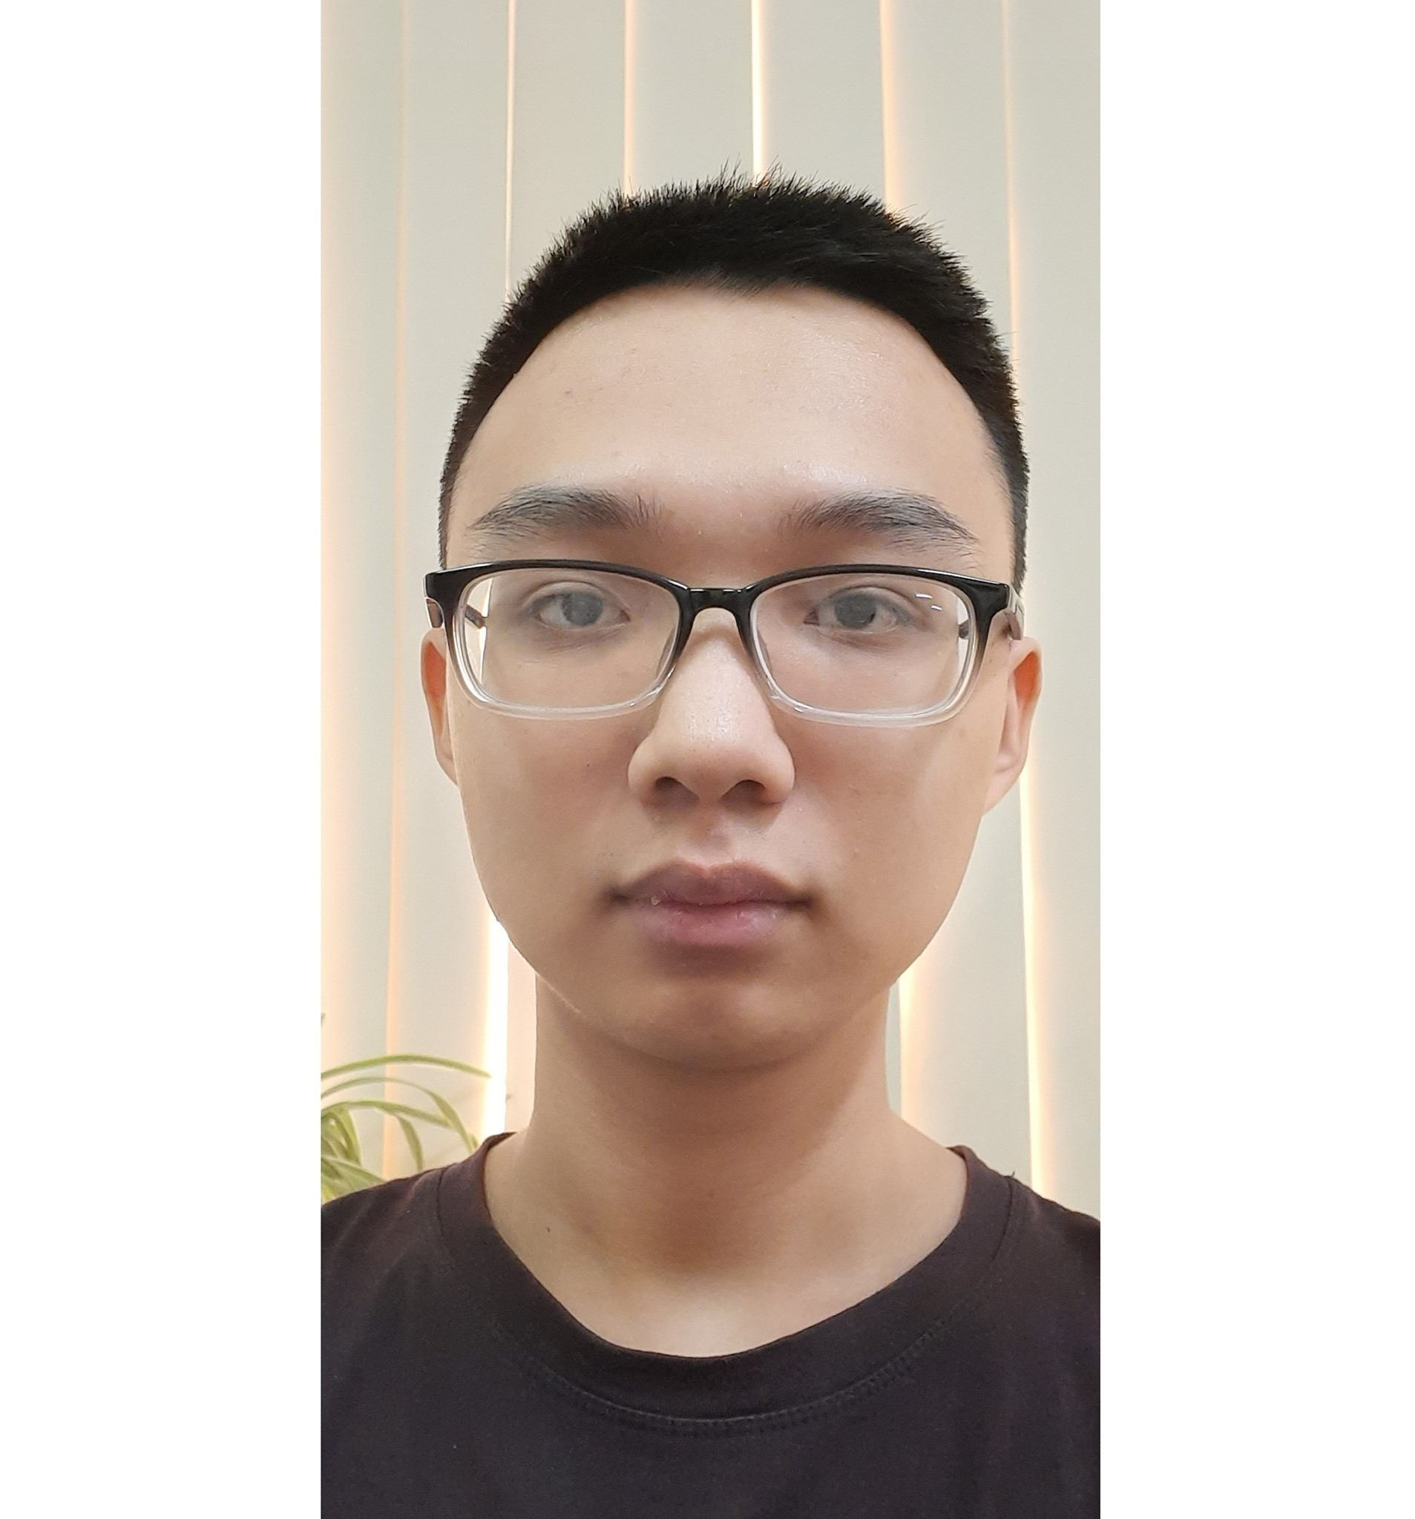


Team
Hoàng Việt
Công Tuấn
Phương Nam
Đình Khang
Leader
Front end
Back end
Design

Slide 3



ToC
Introduction
Specifications
Development
Demo
Duration: 20’

Slide 4

Introduction to the site
Speaker: Hoàng Việt

Slide 5
Bartender website lets visitor choose the ingredients and provide the drinks

Slide 6

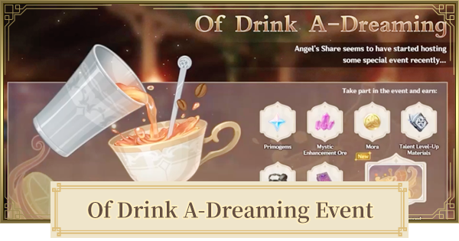
Inspired by Genshin Impact

Slide 7

Ayaya Ayaya

Slide 8
Specifications
Speaker: Công Tuấn, Phương Nam

Slide 9
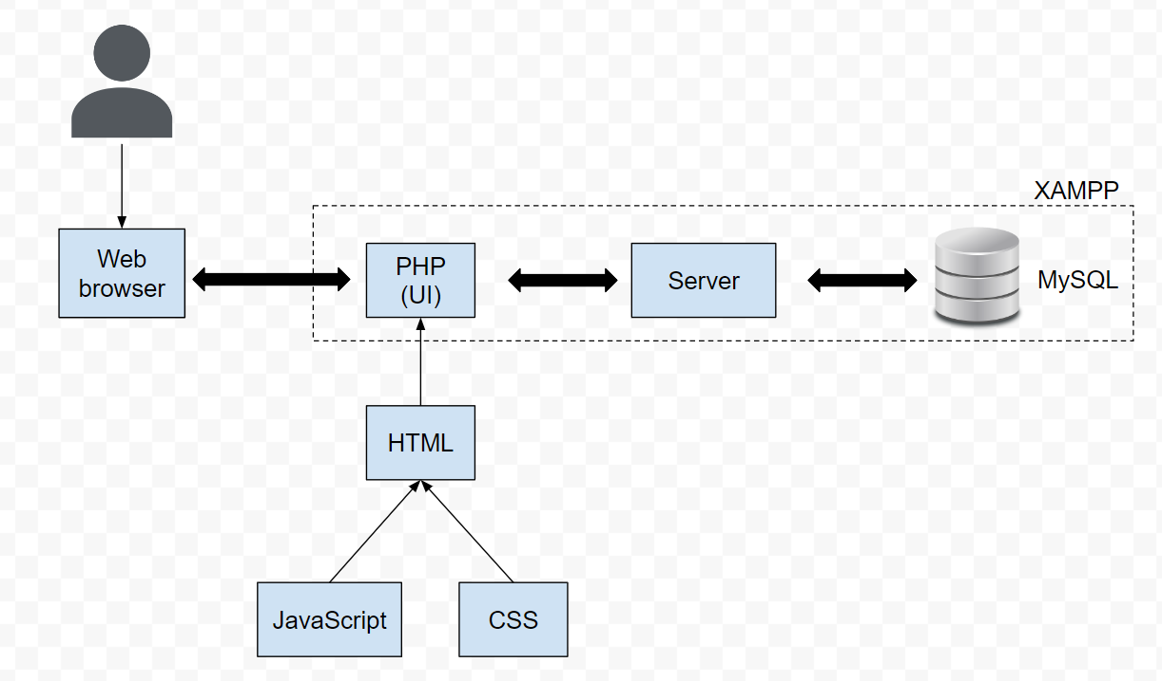
System Design
Version control
Git

Slide 10
Front end
HTML: elements, DOM
CSS: styling for html files
JS: functions, interaction capability
PHP: wrapper, add backend codes

Slide 11
Back end
XAMPP: Easy-to-install Apache distribution containing PHP
MySQL: An open-source relational database management system (RDBMS)

Slide 12
Back end
Add anything if needed

Slide 13
Main use cases
User creates account, log in, log out
Admin deletes account
User searches drinks (input ingredients, output drink name)

Slide 14
Number | Use Case Name | Use Case Description
1 | User register | A visitor to the website clicks on “register”, fills in the form, and submits
2 | User login | A visitor clicks on “log in”, fills in the form, and submit
3 | User change password | A registered user clicks on “forget password” to change
4 | Delete user | Admin bans inappropriate users (bad names, system exploiting, …)
5 | Search recipe | A user searches for the drink by choosing 3 ingredients
User logout by clicking a button. That’s all

Slide 15
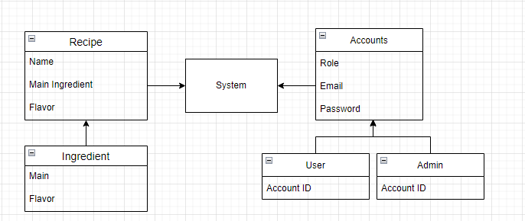
Data Requirements

Slide 16
Development
Speaker: Đình Khang

Slide 17

The way to get started is to quit talking and begin doing.
Walt Disney

Slide 18
Responsibility
 | Việt | Tuấn | Nam | Khang
Week 1 | Brainstorm idea | Prepare front end Design resources | Prepare back end | Prepare system design
Week 2 | Suggest idea Report | Code front end | Improve idea Write report | Improve idea
Week 3 | Write report | Fix front end | Code back end | Write report
Week 4 | Testing | Write report Testing | Write report Testing | Testing

Slide 19
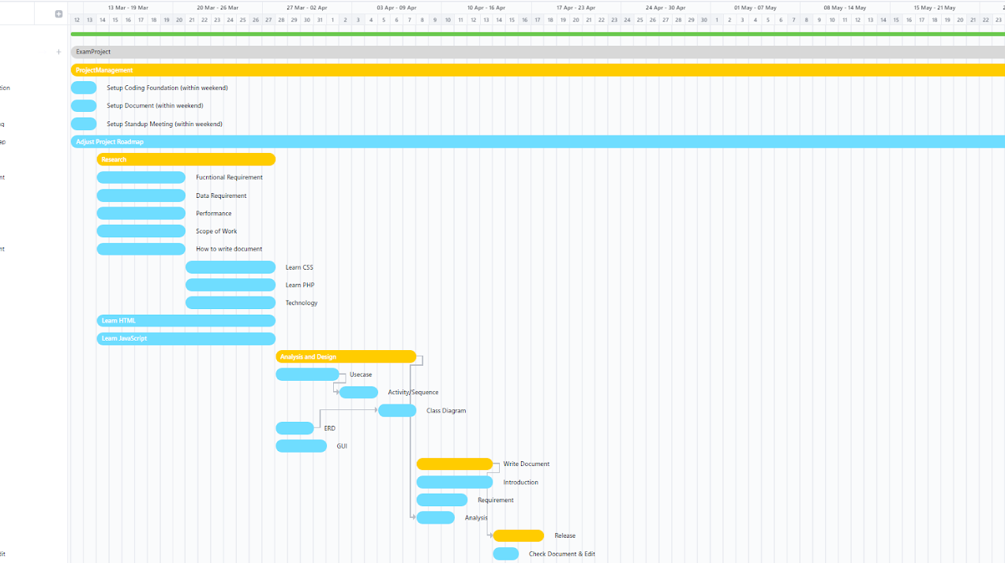
Set up
Check requirements
Check techs
Design system
Documents
Release

Slide 20
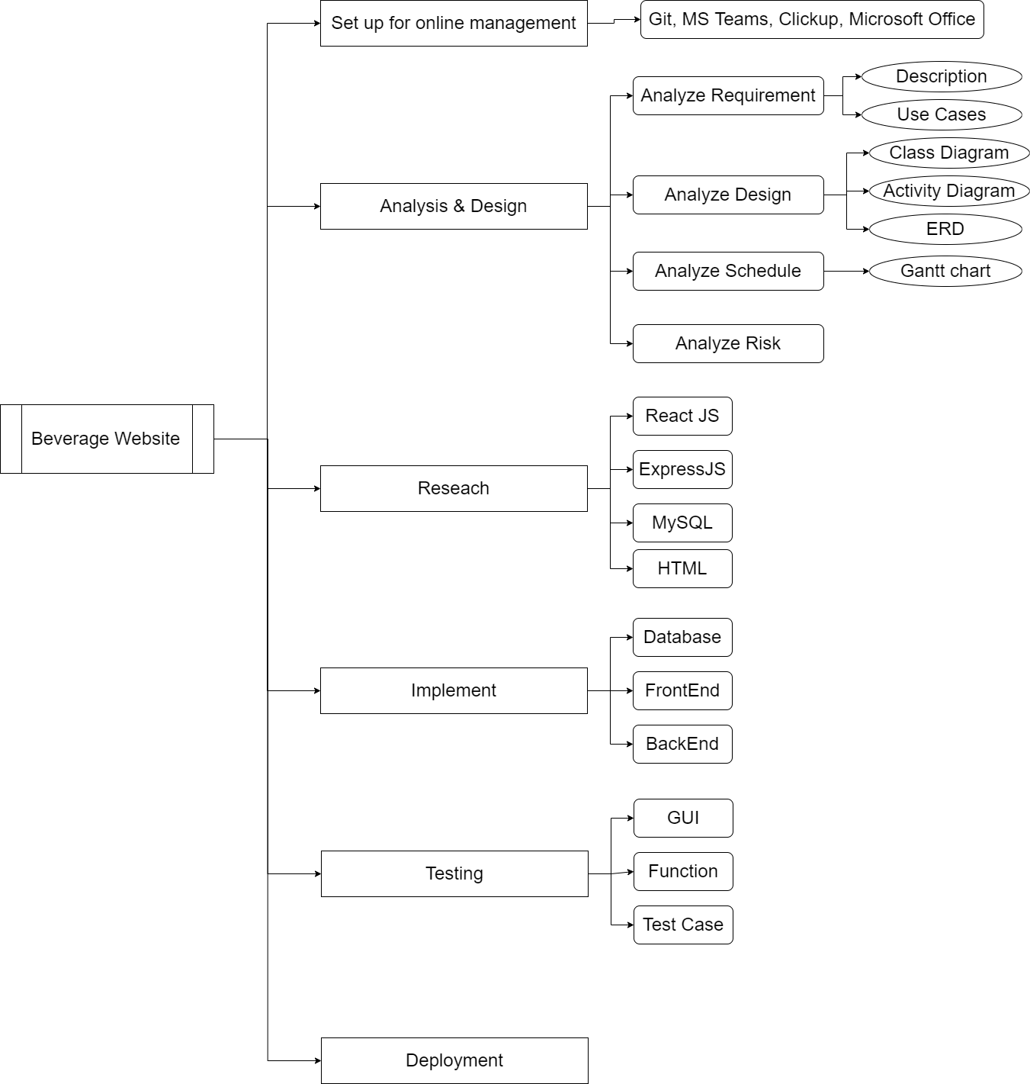
1/2

Slide 21
2/2

Slide 22
Difficulties & Solutions
Overestimate team ability
Lack of time
Back end is a pain
Scale down the project
Set deadlines
Indian youtube tutorials

Slide 23
Demo
Speaker: Phương Nam

Slide 24

Summary
Bartender site combines front end with back end and database to function. With some improvements, it would become a great entertainment.

Slide 25


Thank You

